Slide 1
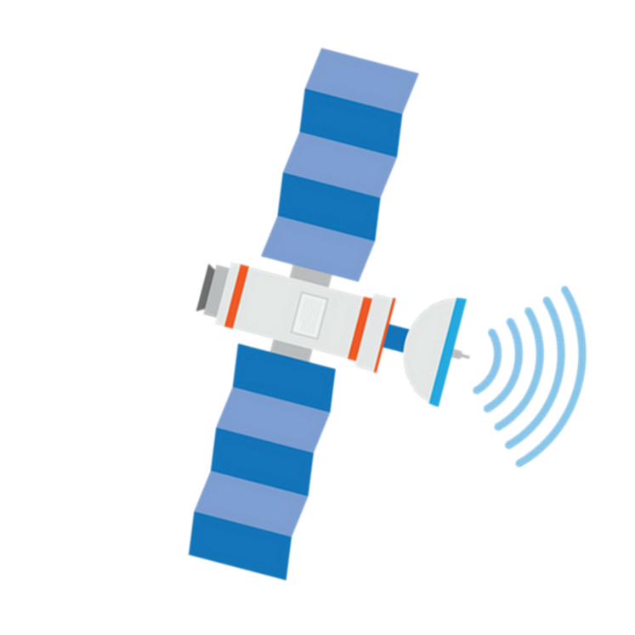


CANACORK
Apresentado por:
Carolina McVey, Duarte Cruz, Manuel Tenazinha, Maria Pagará, Marta Silva, Vicente Santos

Slide 2
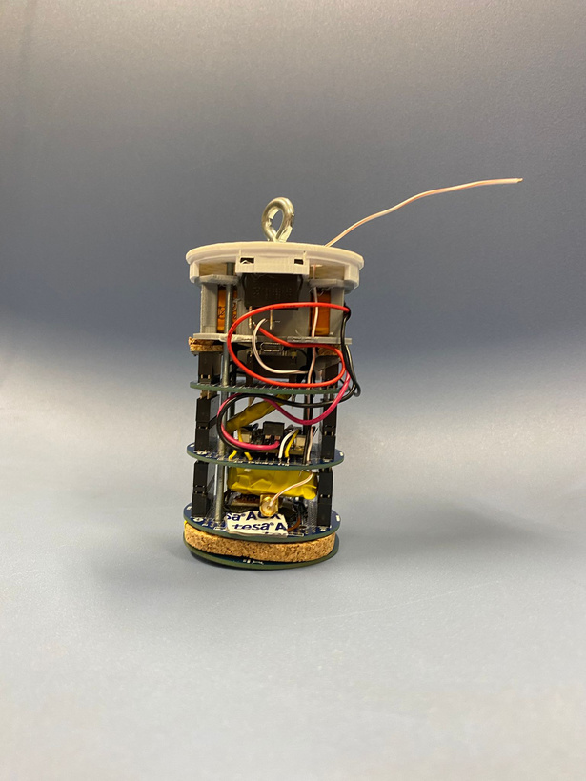
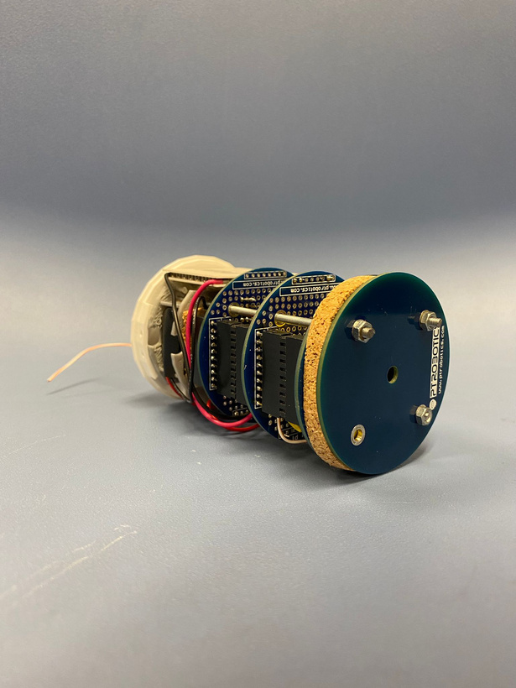
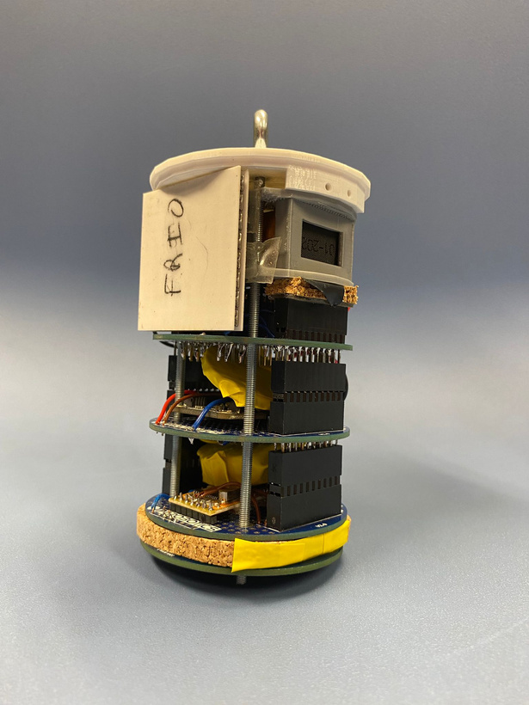
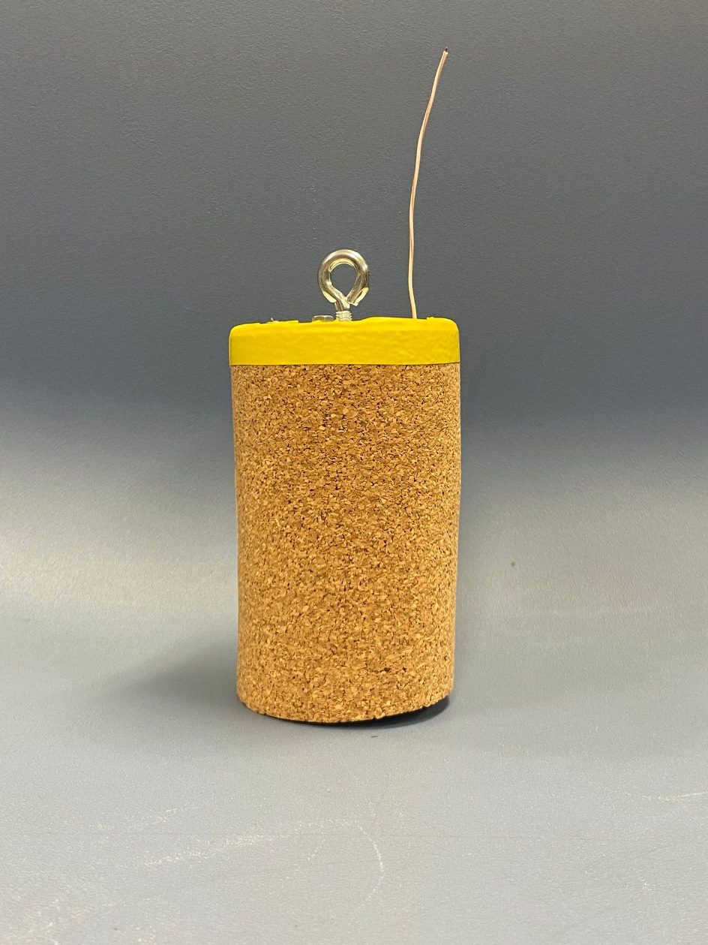
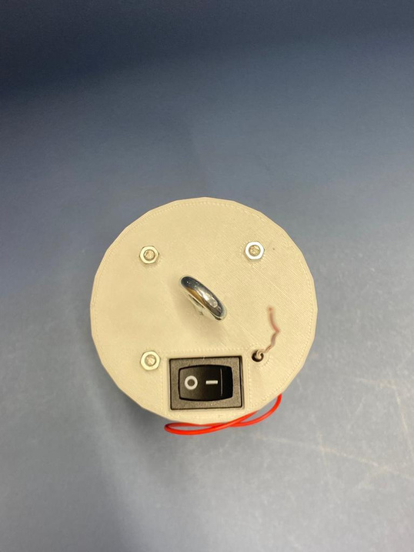
Our Cansat

Slide 3
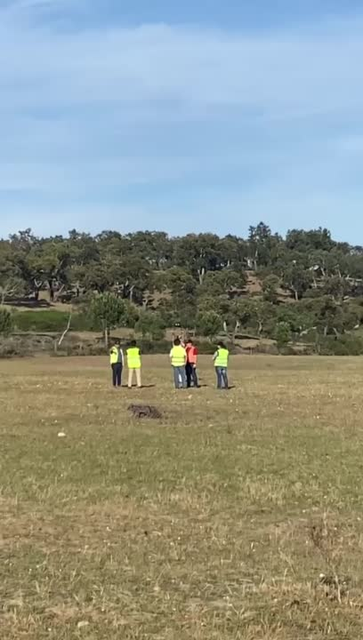
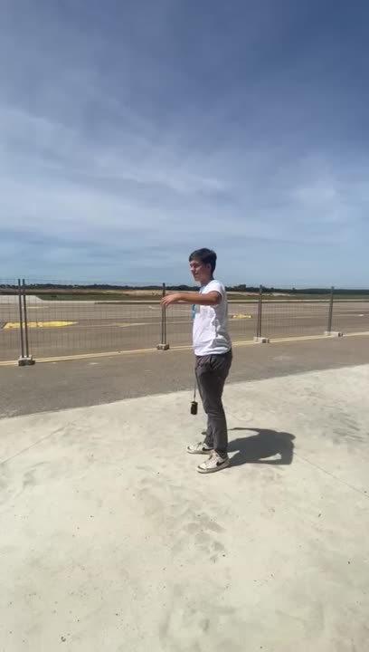
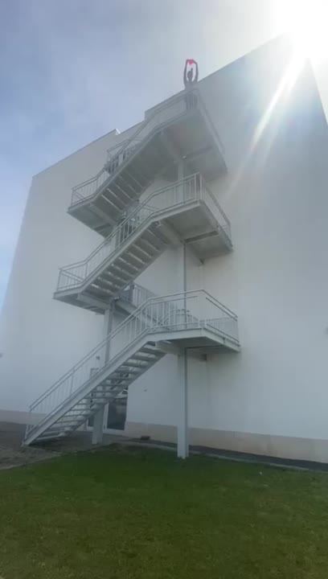
Tests
Telemetry
Acceleration
Parachute

Slide 4
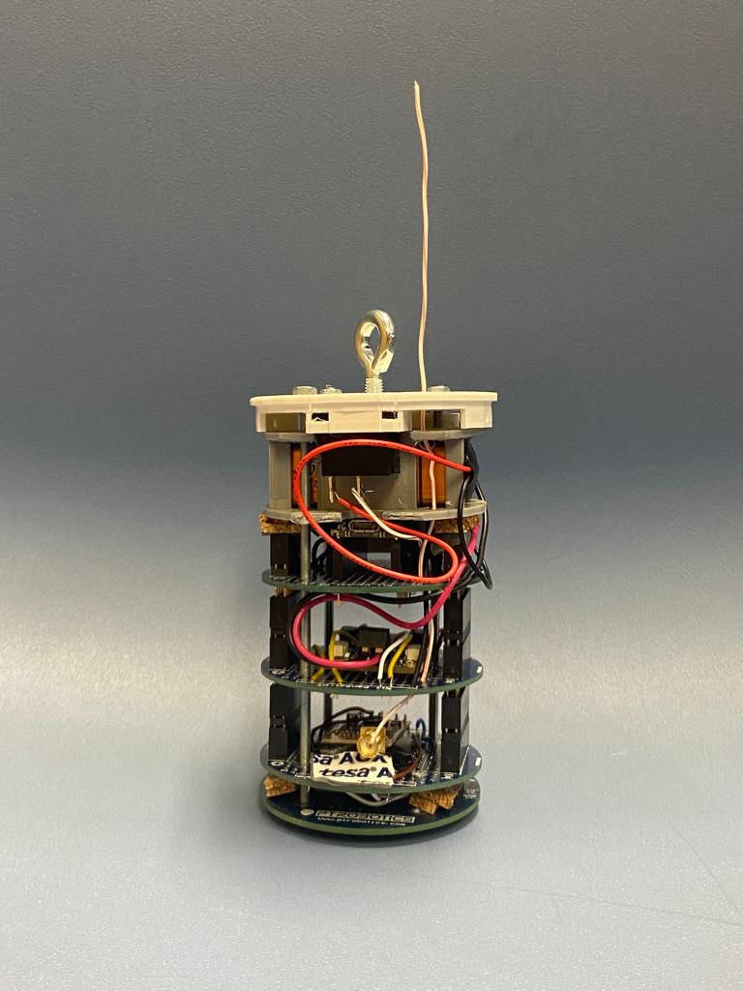
Primary mission

Slide 5
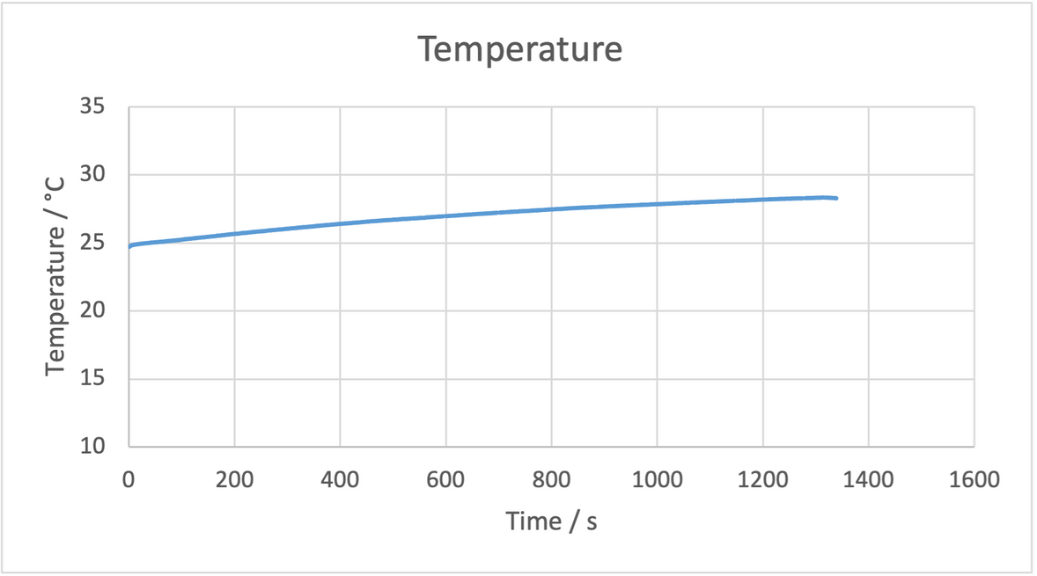
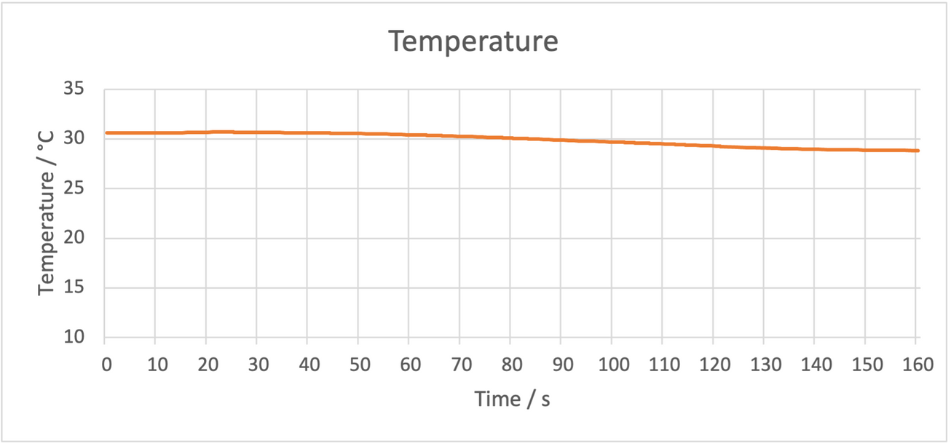
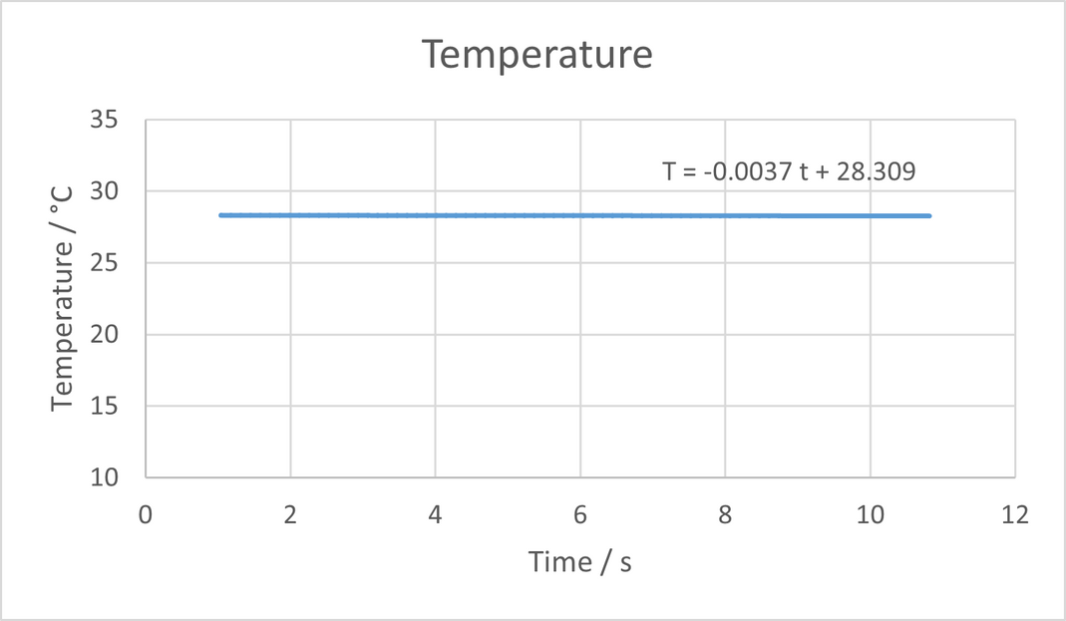
Temperature VS Time

Slide 6
Temperature VS Time

Slide 7
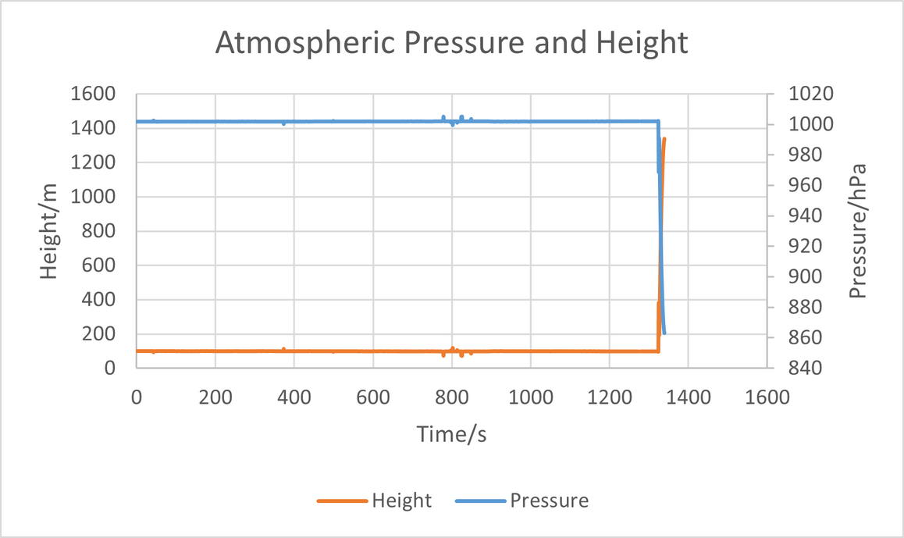
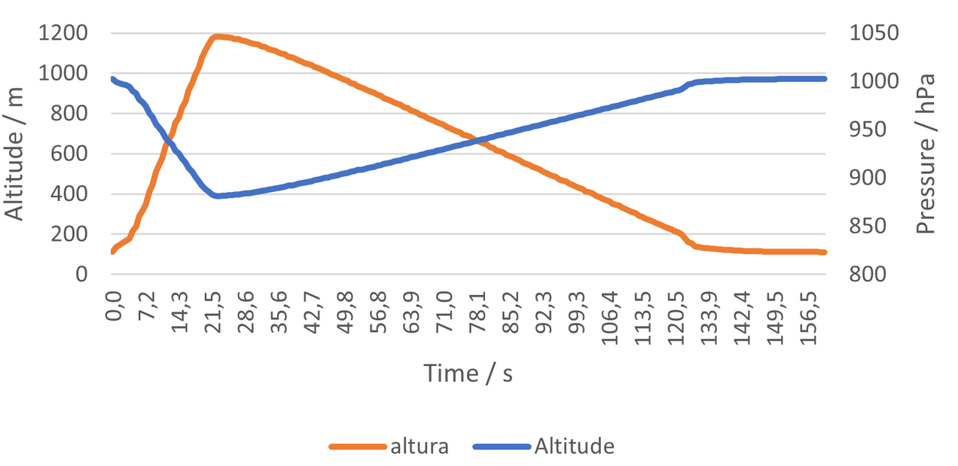
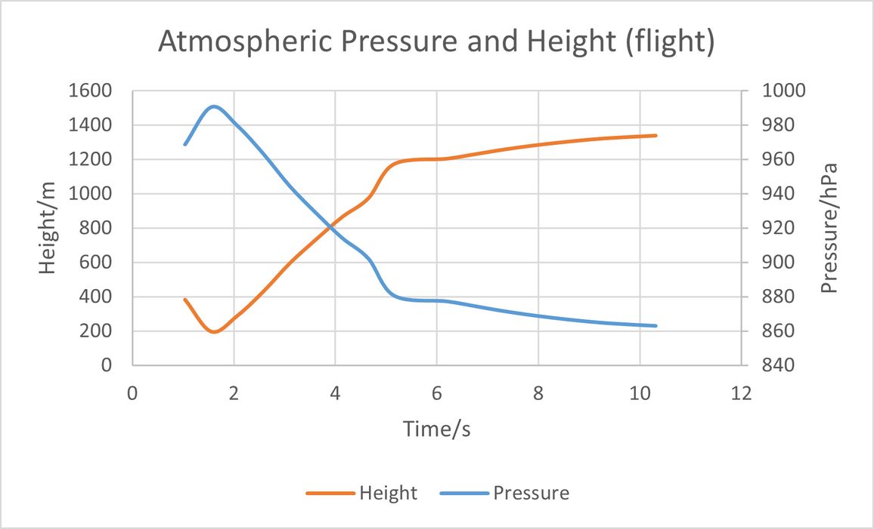
Pressure and Altitude VS Time
Altitude/m
Altitude/m
Altitude
Altitude
Pressure

Slide 8
Pressure and Altitude VS Time
Altitude/m
Altitude/m
Altitude
Pressure

Slide 9

Secondary mission

Slide 10
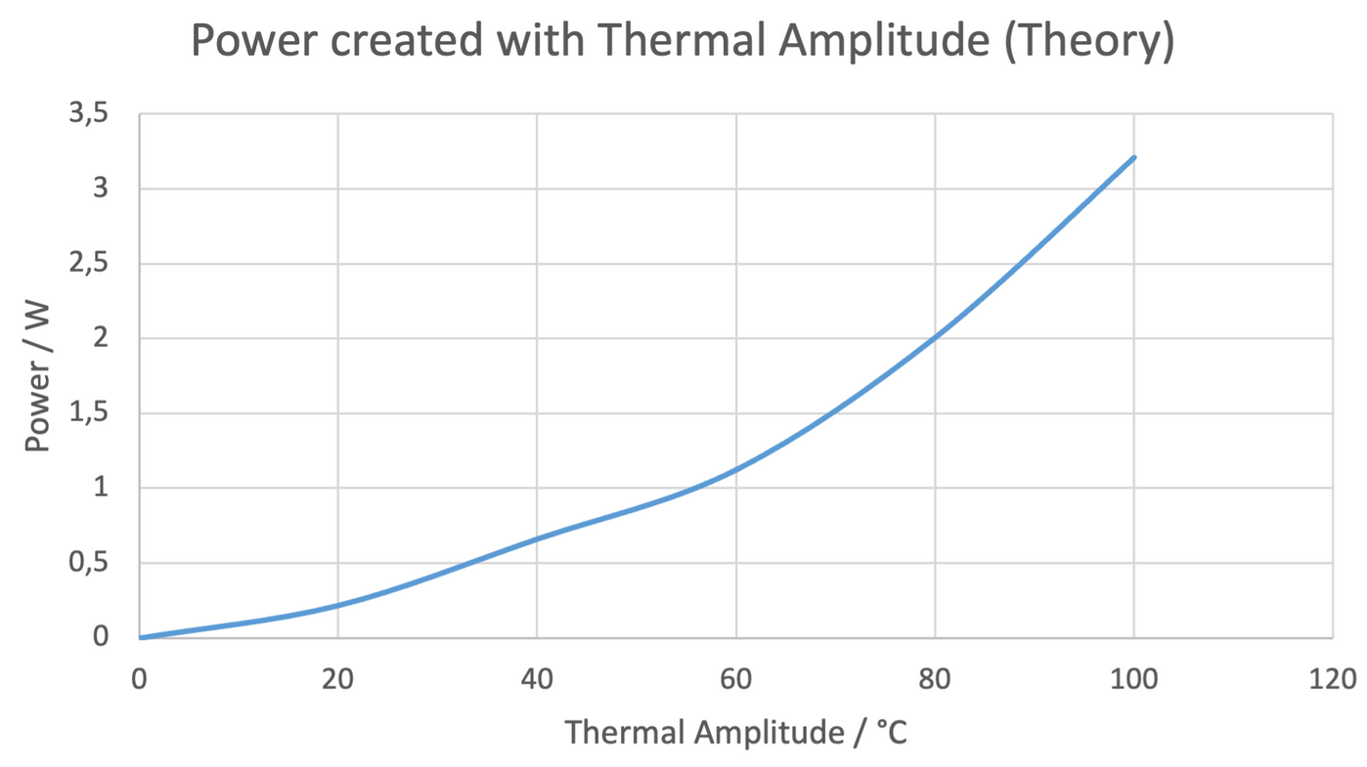
Thermoeletric generator

Slide 11
Launch data

Slide 12
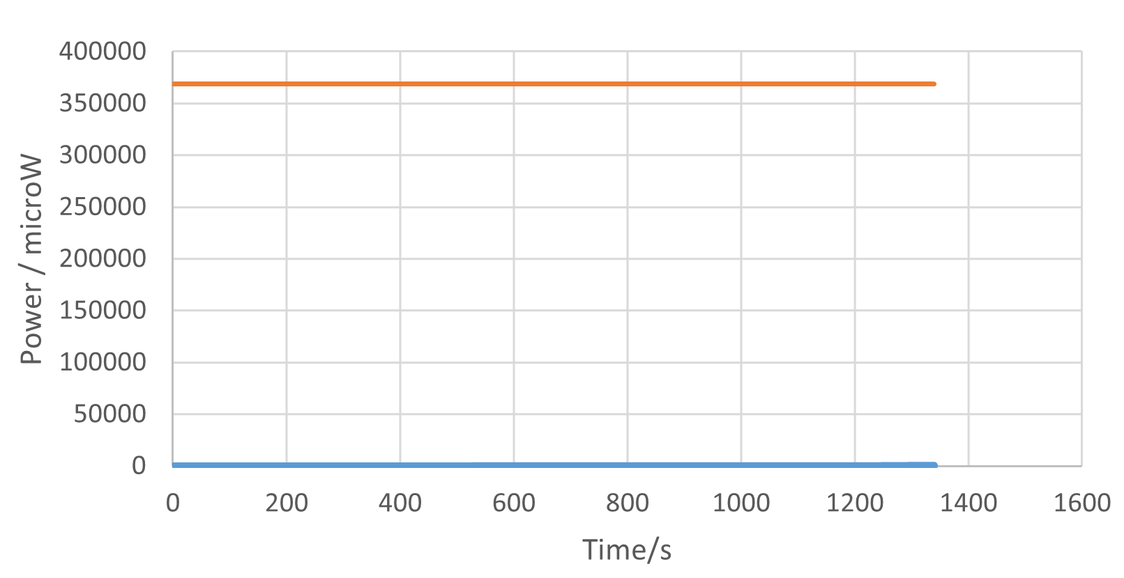
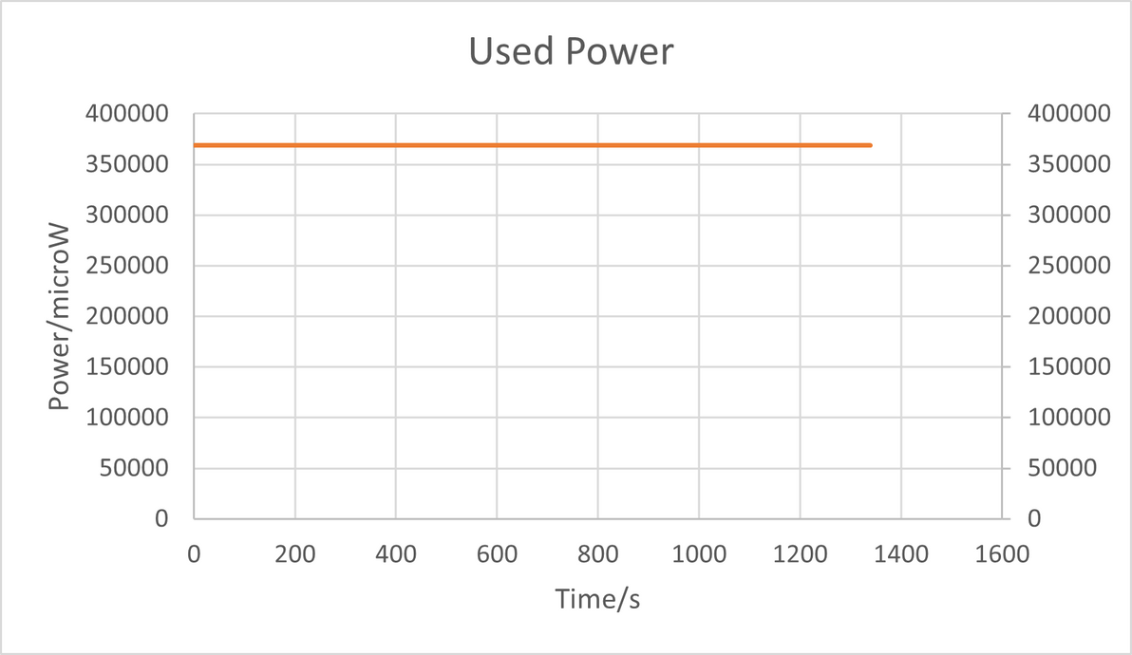
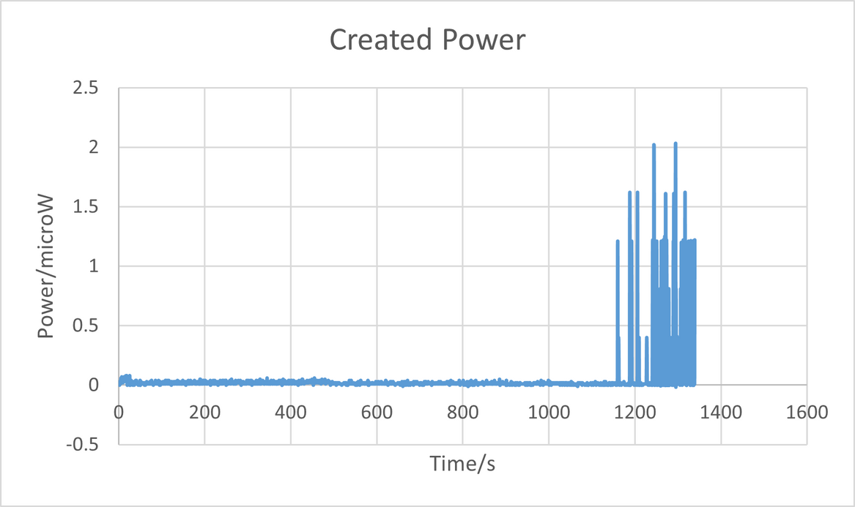
Used Power VS Created Power

Slide 13
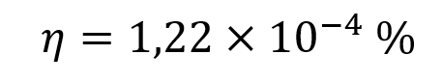
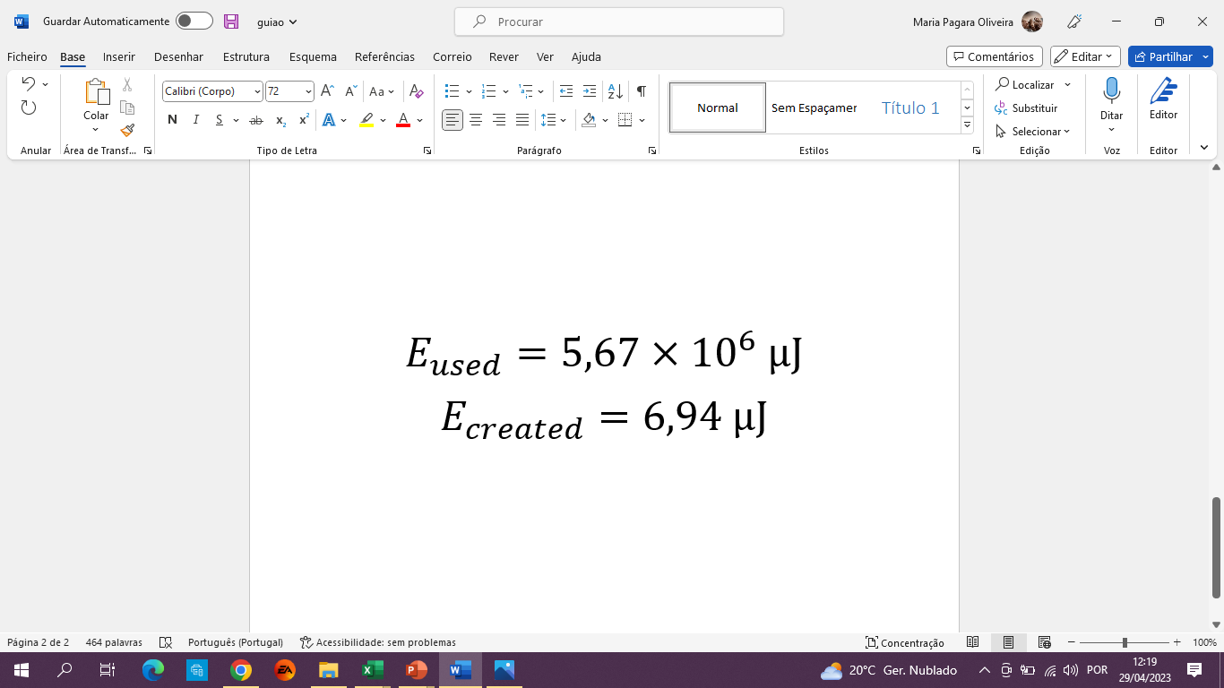
Thermoeletric generator
Area = Energy
Last 15s

Slide 14
Land Experiment

Slide 15
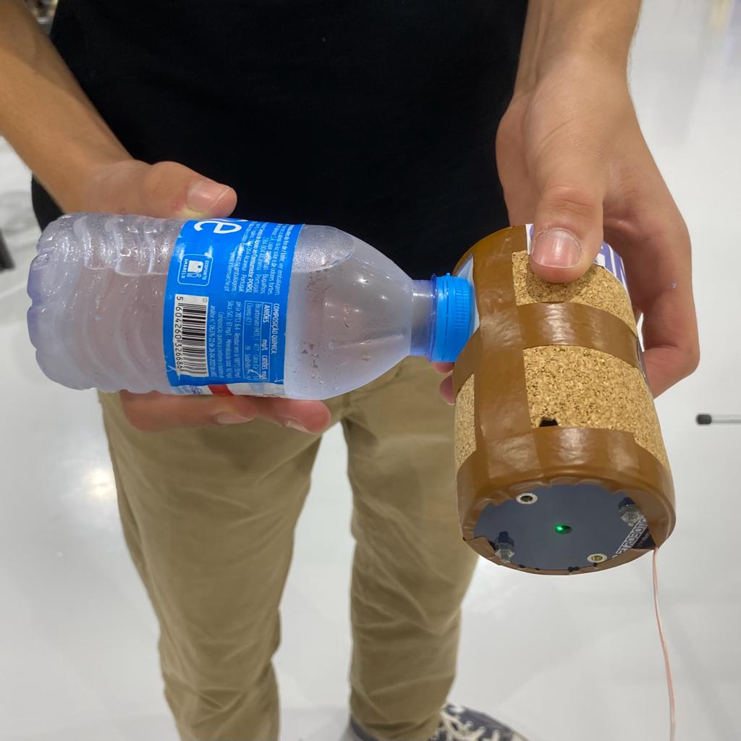
Land Experiment

Slide 16
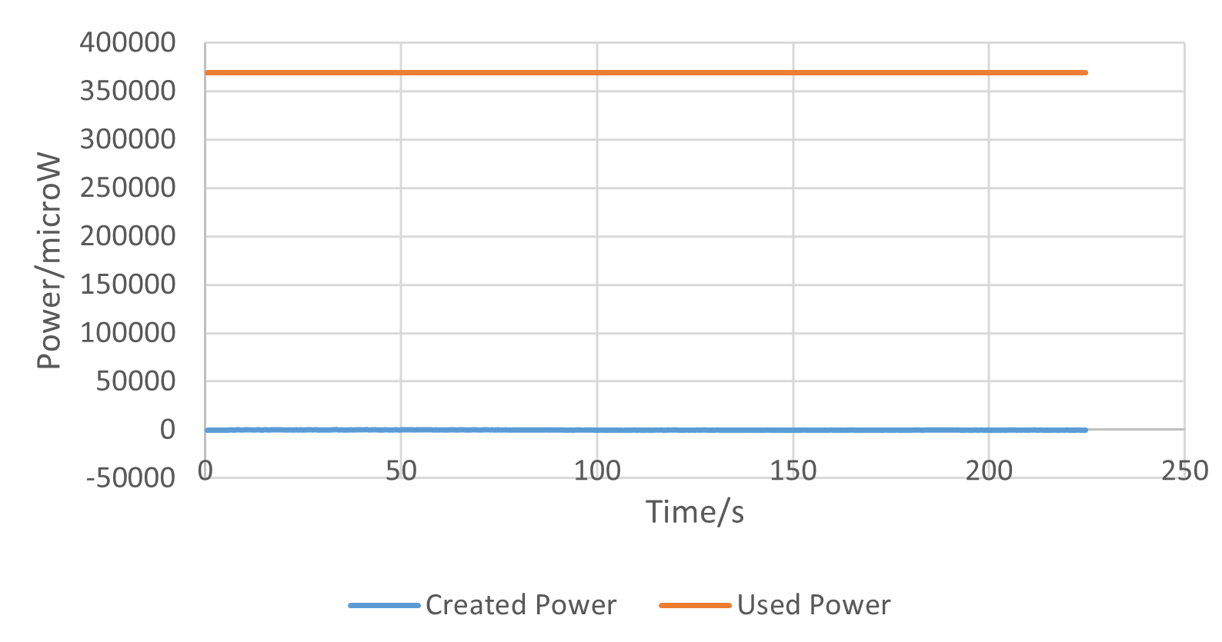
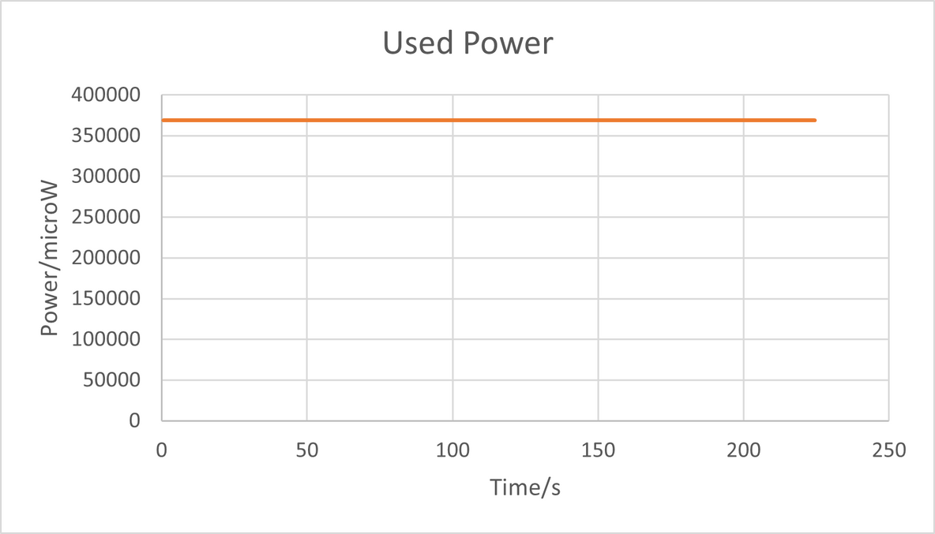
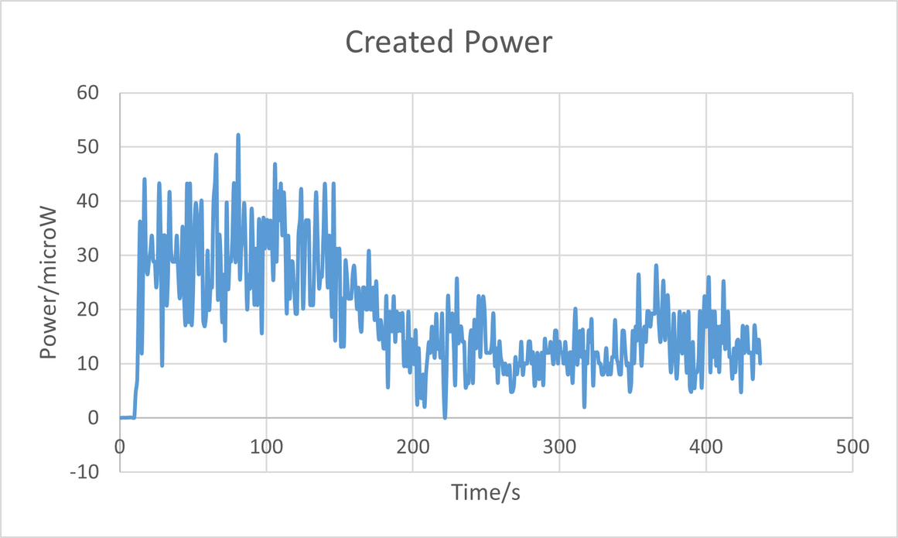
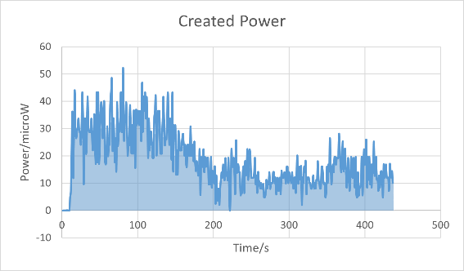
Used Power VS Created Power

Slide 17

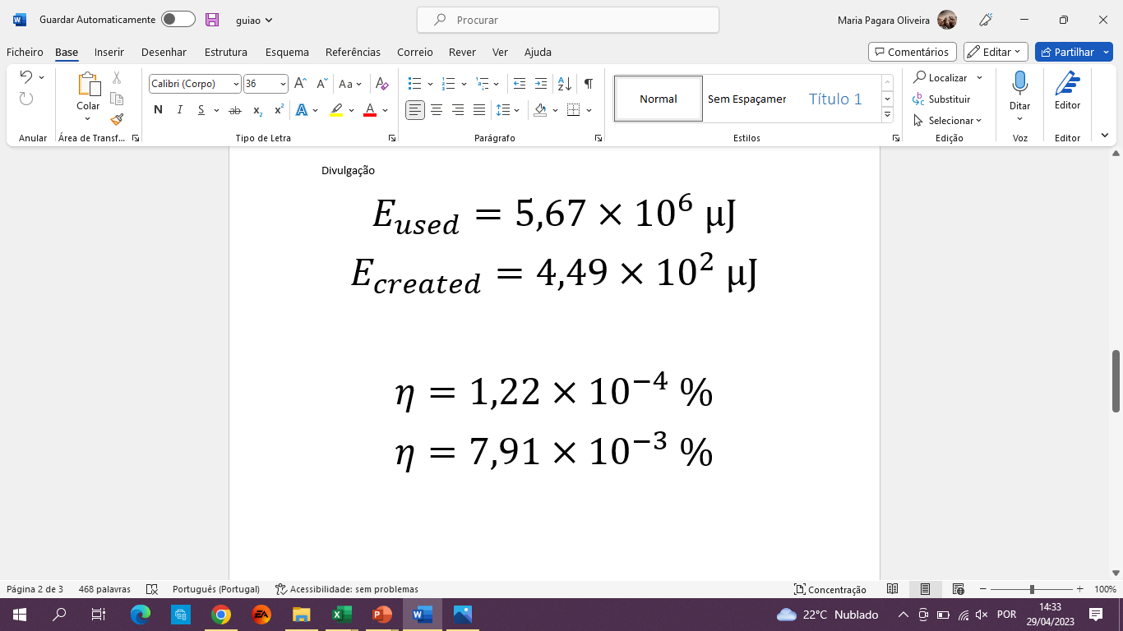
Thermoeletric generator
Area = Energy

Slide 18
Final Conclusions

Slide 19
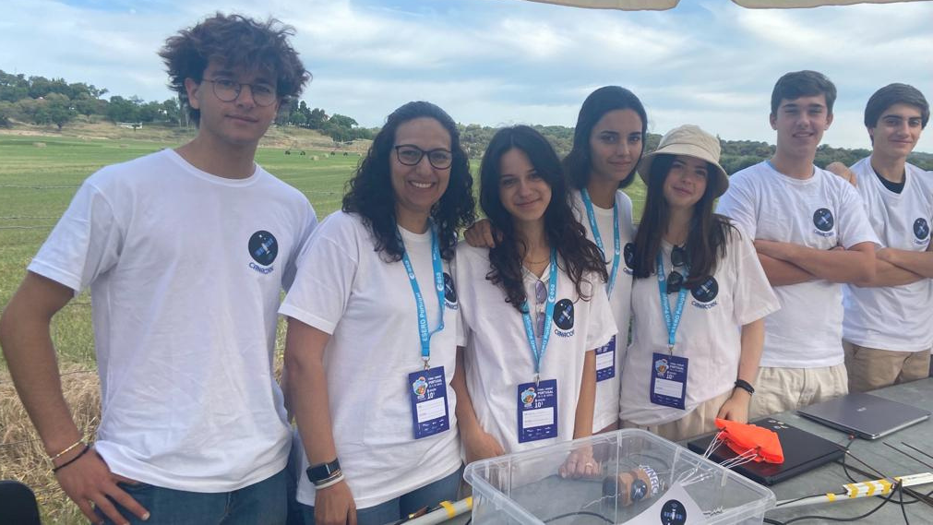


Thank you!
Instagram:
@canacork

